Slide 1

CYBER THREAT INTELLIGENCE

Slide 2

Introduction
Cyber threat intelligence (CTI)
  Minimizing false positives
  Increase the effectiveness

Slide 3
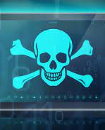
Defination
Threat is defined differently by most of the organizations
For example:
  ISO 27005
  ENISA
What is Threat?

Slide 4
CTI
What is Threat intelligence?
What is Cyber threat intelligence?

Slide 5
What does Cyber Threat Intelligence do?
Identifying types of attacks
Defining, guiding, and prioritizing operational requirements
Understanding threat actor capability, tactics, techniques, and procedures

Slide 6
Types of cyber threats
Malware
Botnets
Spam
Phishing
Data Breaches
Ransomware

Slide 7
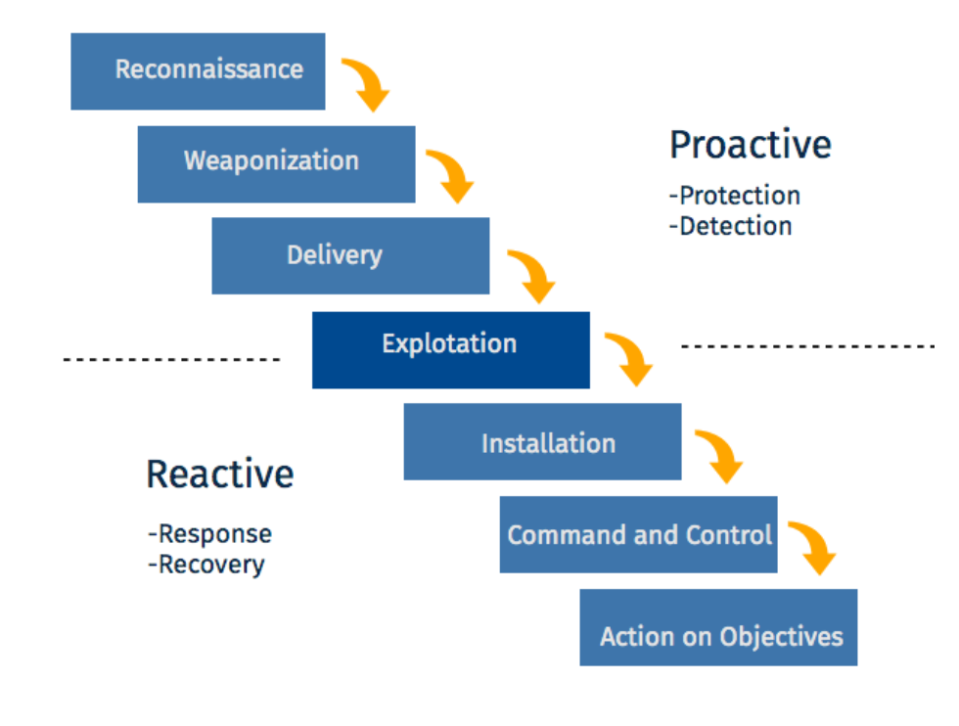
Cyber Kill Chain

Slide 8
Characteristics of Cyber threat intelligence
Timely
Relevant
Accurate
Specific
Actionable

Slide 9
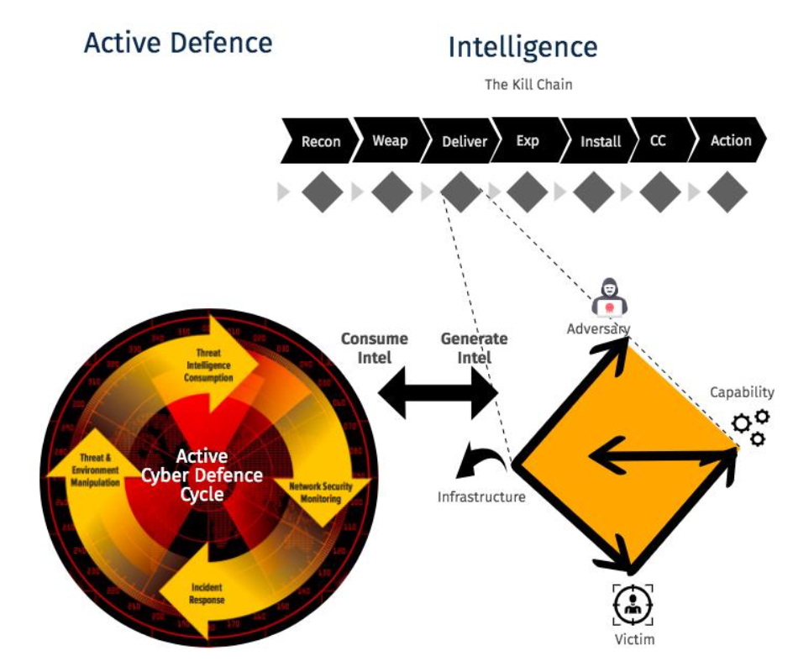
Diamond model
The image shows Continual Process of Generating and Consuming Intelligence for Hunting Threats

Slide 10
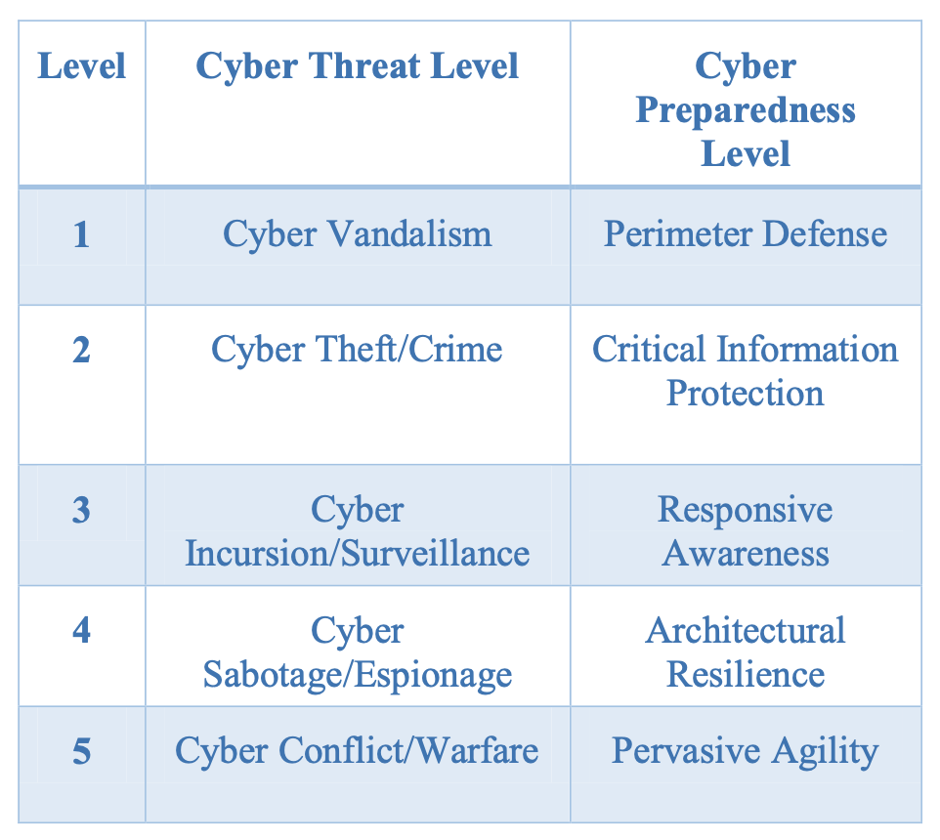
Cyber threat levels

Slide 11
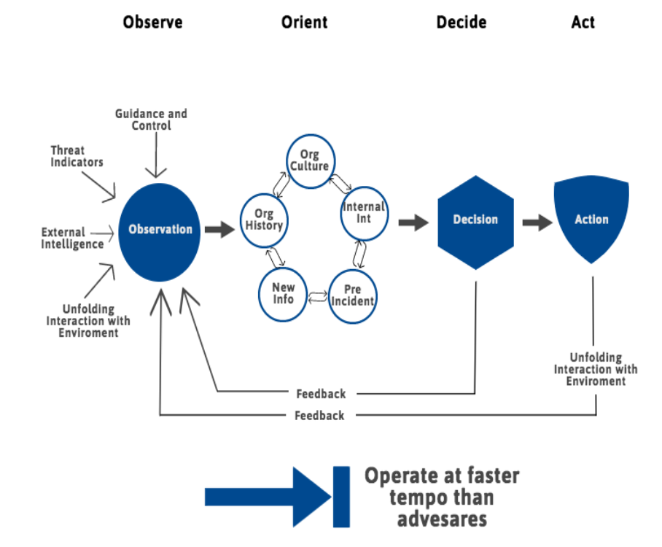
Cyber threat management framework

Slide 12
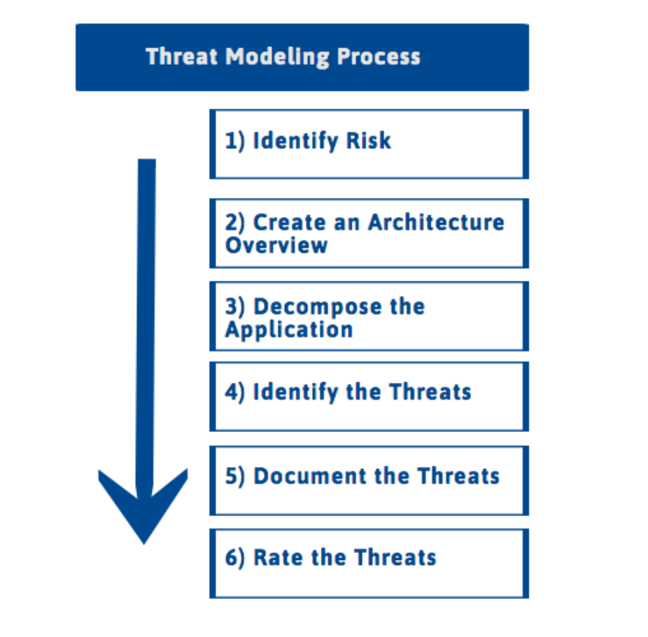
Threat modelling process

Slide 13
Other threat modeling methodologies
STRIDE
PASTA
TRIKE
VAST

Slide 14
Intrusion analysis
Helps to understand the cause of attack after intrusion detection analysis phase
Helps to minimize the after-effects of intrusion
Helps to determine attack signatures

Slide 15

Thank you

